Slide 1
Material Handling
Conveyor Systems
Dr. Mirza Jahanzaib
Dr Haris Aziz
http://www.mhi.org/learning/cicmhe/resources/taxonomy/TransEq/Conv/index.htm

Slide 2
CONVEYOR SYSTEMS
Conveyors are used when material must be moved in relatively large quantities between specific locations over a fixed path.
The fixed path is implemented by a track system, which may be
in-the-Floor.
above-the-Floor, or
overhead.

Slide 3
Categories of Conveyors
Powered Conveyors:
In powered conveyors, the power mechanism is contained in the fixed path, using chains. belts, rotating rolls, or other devices to propel loads along the path.
Powered conveyors are commonly used in automated material transport systems in manufacturing plants, warehouses, and distribution centers.

Slide 4
Categories of Conveyors
Non-Powered Conveyers:
In non-powered conveyors, materials are moved either manually by human workers who push the loads along the fixed path or by gravity from one elevation to a lower elevation.

Slide 5
Types of Conveyors
A variety of conveyor equipment is commercially available.
But we will focused mainly on the powered conveyors organized according to the type of mechanical power provided in the fixed path.

Slide 6
Types of Conveyors
Roller and Skate Wheel Conveyors.
These conveyors have rolls or wheels on which the loads ride. Loads must possess a flat bottom surface of sufficient area to span several adjacent rollers. Pallets, tote pans, or cartons serve this purpose well. The two main entries in this category are roller conveyors and skate wheel conveyors pictured in Figure.

Slide 7
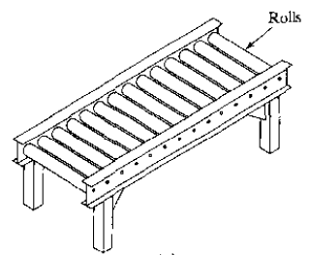
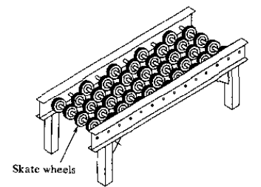
Roller and Skate Wheel Conveyors
What is the difference?

Slide 8
Types of Conveyors
Belt Conveyors.
Belt conveyors consist of a continuous loop: Half its length is used for delivering materials, and the other half is the return run. The belt is made of reinforced elastomer (rubber}, so that it possesses high flexibility but low extensibility.
At one end of the conveyor is a drive roll that powers the belt.

Slide 9
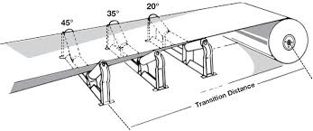
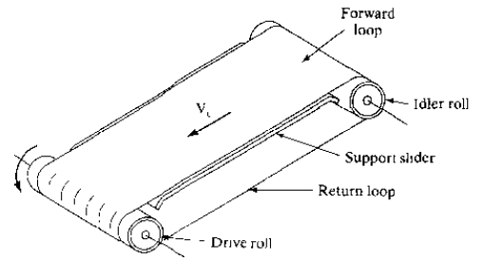
Belt conveyors
Belt conveyors are available in two common forms:
(1) Flat belts for pallets,
(2) Troughed belts for bulk materials.

Slide 10
Conveyors Driven by Chains and Cables.
The conveyors in this group are driven by a powered chain or cable that forms an endless loop.
One or more chains operating in parallel may be used to form the conveyor.

Slide 11
Sub-Categories of Chain & Cable Conveyors
The following conveyors are in this category:
(I) Chain.
(2) Slat.
(3) In-floor towline.
(4) Overhead trolley.
(5) Power-and-free overhead trolley.

Slide 12
Chain Conveyors
Chain conveyors consist of chain loops in an over-and-under configuration around powered sprockets at the ends of the pathway.
The chains travel along channels in the floor that provide support for the flexible chain section.
The loads are generally dragged along the pathway using bars that project up from the moving chain.

Slide 13
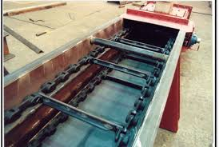
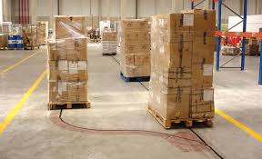

Slide 14
Slat Conveyors
The slat conveyor uses individual platforms called slats connected to continuously moving chain.
Although the drive mechanism is powered chain it operates much like a belt conveyor.
Loads are placed on the slats and are transported along with them.

Slide 15
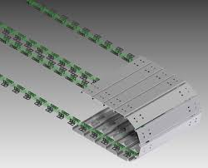

Slide 16
In-Floor Towline
These conveyors make use of four-wheel carts powered by moving chains or cables located in trenches in the floor.
The chain or cable is called a towline hence the name of the conveyor. Pathways for the conveyor system are defined by the trench and cable and the cable is driven as a powered pulley system.

Slide 17
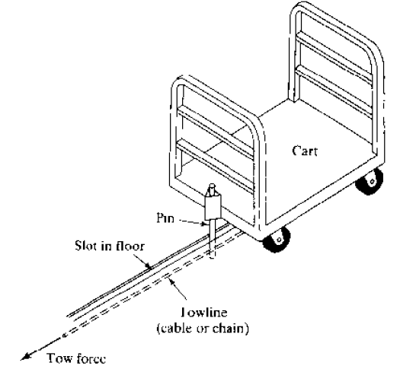
In-Floor Towline

Slide 18
Overhead trolley
An overhead trolley conveyor as in given figure consists of multiple trolleys, usually equally spaced along a fixed track.
The trolleys are connected together and moved along the track by means of a chain of cable that forms a complete loop.
Suspended from the trolleys are hooks, baskets, or other receptacles to carry loads.
The chain (or cable) is attached to a drive wheel that supplies power to move the chain at a constant velocity.

Slide 19
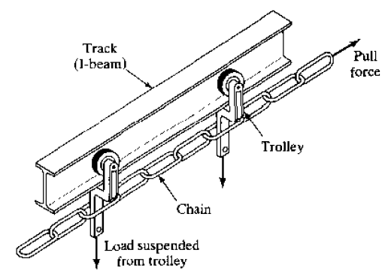
Overhead trolley

Slide 20
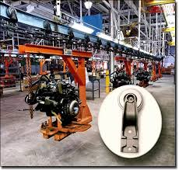
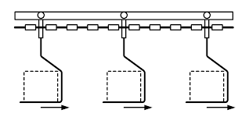

Slide 21
Power-and-free overhead trolley
A power-and-free overhead trolley conveyor is similar to the overhead trolley conveyor, except that the trolleys are capable of being disconnected from the drive chain providing this conveyor with an asynchronous capability.
This is usually accomplished by using two tracks, one just above the other.

Slide 22
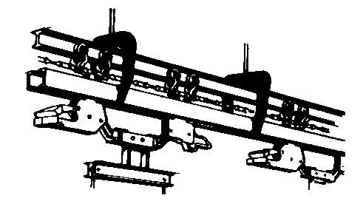
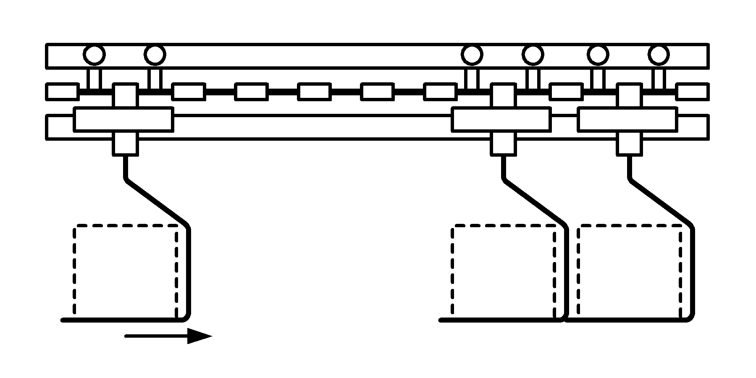

Slide 23
Cart-on-track conveyors
Cartoon-track conveyors consist of individual carts riding on a track a few feet above floor level.
The carts are driven by means of a rotating shaft,
A drive wheel, attached to the bottom of the cart and set at an angle to the rotating tube, rests against it and drives the cart forward.
The cart speed is controlled by regulating the angle of contact between the drive wheel and the spinning tube.

Slide 24
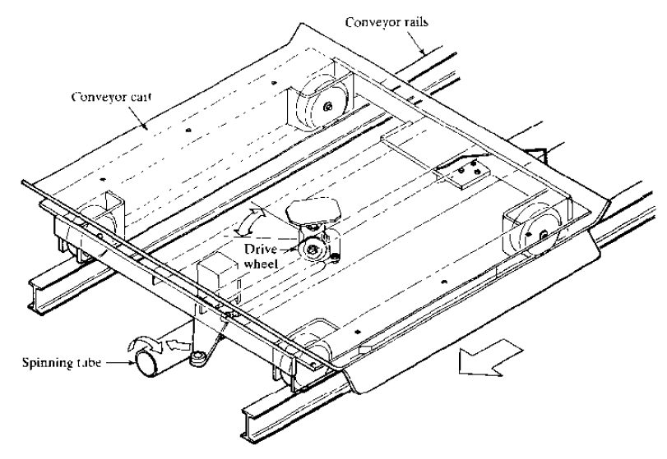
Cart-on-track conveyors

Slide 25
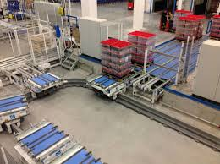

Slide 26
Screw conveyors
Screw conveyors arc based on the Archimedes screw, the water-raising device devised in ancient times (circa 236 B.C.)
It consists of a large screw inside a cylinder, turned by hand to pump water up-hill for irrigation purposes.

Slide 27
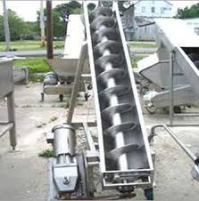
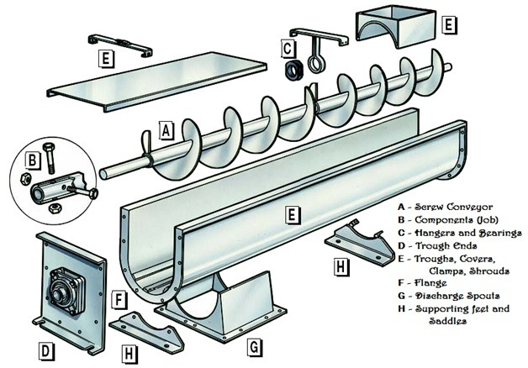

Slide 28
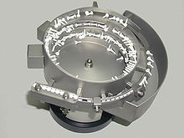
Vibration-based conveyors
Vibration-based conveyors use a flat track connected to an electromagnet that imparts an angular vibratory motion to the track to propel items in the desired direction.
This same principle is used in vibratory bowl feeders to deliver components in automated assembly systems.

Slide 29
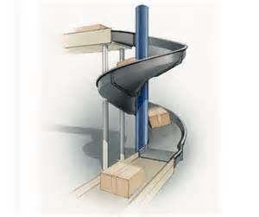
Vertical Lift conveyors
Vertical lift conveyors include a variety of mechanical elevators designed to provide vertical motion, such as between floors or to link floor-based conveyors with overhead conveyors.
Other conveyor types include non-powered chutes, ramps. and lubes, which are driven by gravity.

Slide 30
Conveyor Operations and Features
Conveyor systems divide into two basic types in terms of the characteristic motion of the materials moved by the system:
(1) Continuous
(2) Asynchronous.

Slide 31
Conveyor Operations and Features
Continuous motion conveyors move at a constant velocity Vc along the path. They include belt, roller, skate-wheel. overhead trolley, and slat conveyors,

Slide 32
Conveyor Operations and Features
Asynchronous conveyors operate with a stop- and-go motion in which loads, usually contained in carriers (e.g., hooks, baskets, carts), move between stations and then stop and remain at the station until released.
Examples of this type include overhead power-and-free trolley, in-floor towline, and carton-track conveyors.

Slide 33
Why use Asynchronous conveyors:
To accumulate loads.
Temporary storage.
To allow for differences in production rates between adjacent processing areas.
To smooth production when cycle times vary at stations along the conveyor.
To accommodate different conveyor speeds along the pathway.

Slide 34
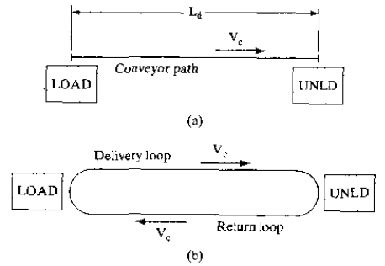
Classifications of Conveyors
Conveyors can also be classified as:
(1) Single direction.
(2) Continuous loop.
(3) Re-circulating.

Slide 35
Single Direction Conveyors
Materials are loaded at one end and unloaded at the other.
Assuming the conveyor operates at a constant speed, the time required to move materials from load station to unload station is given by:
where Td= delivery time (min), Ld = length of conveyor between load and unload stations
(m, ft), and Vc = conveyor velocity (m/min, ft/min).

Slide 36
Single Direction Conveyors
The flow rate of materials on the conveyor is determined by the rate of loading at the load station.
Where Rf = material flow rate (parts/min), RL = loading rate (parts/min),Sc = center to-center spacing of materials on the conveyor (m/part, ft/part) and TL = loading time (min/part).

Slide 37
Single Direction Conveyors
The time required to unload the conveyor must be equal to or less than the loading time.
The advantage of the unit load principle can be demonstrated by transporting np parts in a carrier rather than a single part.

Slide 38
Example
A roller conveyor follows a pathway 35m long between a parts production department and an assembly department. Velocity of the conveyor is 40 m/min. Parts are loaded into large tote pans, which are placed onto the conveyor at the load station in the production department. Two operators work the loading station. The first worker loads parts into tote pans, which takes 25 sec. Each tote pan holds 20 parts. Parts enter the loading station from production at a rate that is in balance with this 25sec cycle. The second worker loads tote pans onto the conveyor, which takes only 10 sec.
Determine: (a) spacing between tote pans along the conveyor, (b) maximum possible flow rate in parts/min. and (c) the minimum time required to unload the tote pan in the assembly department.

Slide 39
Solution
(a) Sc = (25/60 min)(40 m/min) = 16.67m
(b) Flow rate is:
(c) This flow rate is one tote pan every 25sec. Therefore

Slide 40
Continuous Loop Conveyors.
The length of the delivery loop is Ld, and the length of the return loop is Le.
Total length of the conveyor is:
The total time required to travel the complete loop is:

Slide 41
Continuous Loop Conveyors.
The time a load spends in the forward loop is:
Carriers are equally spaced along the chain at a distance Sc apart. Thus, the total number of carriers in the loop is given by:

Slide 42
Continuous Loop Conveyors.
The maximum number of parts in the system at anyone time is given by:
Total parts in system
As in the single direction conveyor, the maximum flow rate between load and unload stations is

Slide 43
Re-circulating Conveyors: Kwo Analysis.
According to Kwo, there are three basic principles that must be obeyed in designing such a conveyor system:
(1) Speed Rule.

Slide 44
Re-circulating Conveyors: Kwo Analysis.
(2) Capacity Constraint.
(3) Uniformity Principle.
This principle states that parts (loads) should be uniformly distributed throughout the length of the conveyor, so that there will be no sections of the conveyor in which every carrier is full while other sections are virtually empty.

Slide 45
Example
A re-circulating conveyor has a total length of 300m .Its speed is 60 m/min and the spacing of part carriers along its length is 12 m. Each carrier can hold two parts.
The task time required to load two parts into each carrier is 0.20 min and the unload time is the same, The required loading and unloading rates are both defined by the specified flow rate, which is 4 parts/min. Evaluate the conveyor system design with respect to Kwo's three principles.

Slide 46
Solution
(1) Speed Rule.
So the Speed Rule is satisfied.

Slide 47
Solution
(2) Capacity Constraint.
The conveyor flow rate capacity = 10 parts/min as computed above.
Since this is substantially greater than the required delivery rate of 4 part/min, the capacity constraint is satisfied.
(3) Uniformity Principle.
The conveyor is assumed to be uniformly loaded throughout its length, since the loading and unloading rates are equal and the flow rate capacity is substantially greater than the load/unload rate.

Slide 48
Assignment and Quiz 2
Problem | Group
24 | 1
23 | 2
22 | 3
21 | 4
20 | 5
19 | 6
18 | 7
25 | -

